Slide 1

Regression
Group - 5

Slide 2
WHAT IS REGRESSION (MEDICAL EXPENSES)?
In the context of medical expenses, regression analysis is a statistical method used to predict or estimate the value of a dependent variable (like medical costs) based on the values of one or more independent variables (like age, BMI, smoking status, etc.). It essentially helps to understand how different factors relate to and influence healthcare costs.

Slide 3
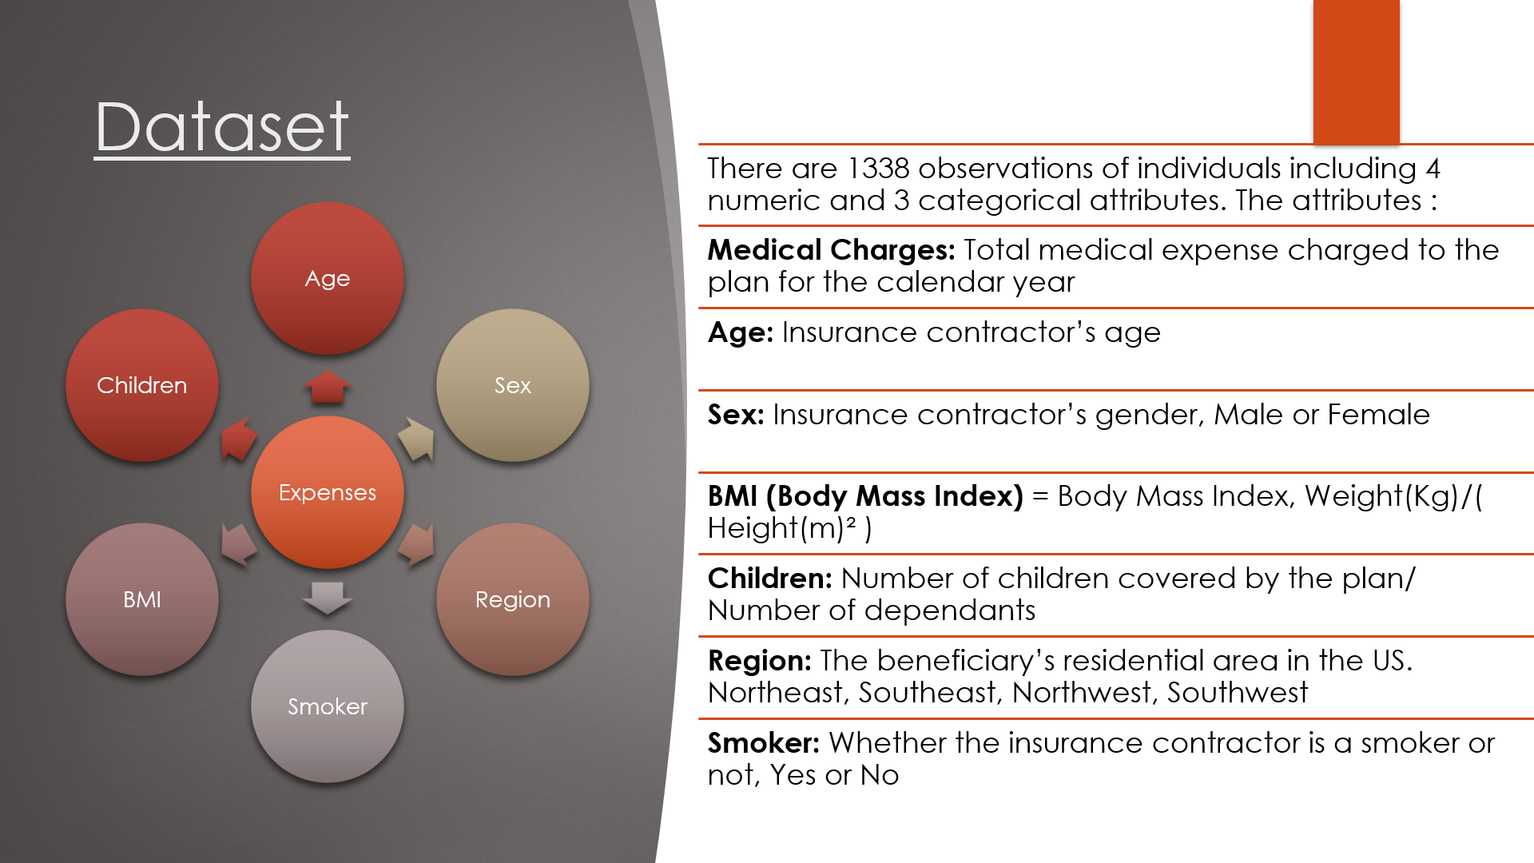

Slide 4
OBJECTIVE
This project addresses the challenge of rising healthcare costs by predicting individual medical expenses. The primary objective is to identify and interpret the key demographic and personal factors that significantly influence insurance charges, such as age, BMI, and smoking habits.

Slide 5
ABOUT DATASET
Data Pre-processing: The initial dataset of 1,338 observations was cleaned by identifying and removing outliers from the charges and bmi variables, resulting in a refined dataset of 1,116 observations for modeling.
Exploratory Data Analysis (EDA): A correlation matrix and pair plots were used to understand the initial relationships between variables.
Model Development & Selection: Three distinct linear regression models were developed, including a baseline model, a model with a custom interaction term (smoker & obesity), and a log-transformed model.

Slide 6
Uses insurance.csv with the following columns:
age: Age of the beneficiary
sex: Gender
bmi: Body Mass Index
children: Number of dependents
smoker: Smoking status
region: Residential region (US)
expenses: Medical insurance cost (target)

Slide 7
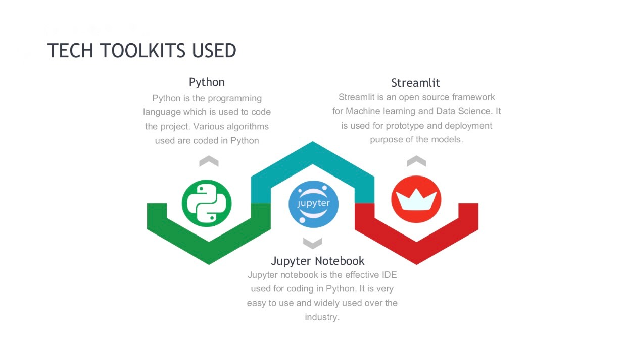

Slide 8


+--------------------------+
| Multiple Linear |
| Regression |
+-----------+-------------+
|
| Add Regularization
v
+-----------+-------------+
| Ridge Regression |
+-----------+-------------+
|
| Non-linearity & Higher Accuracy
v
+--------------+--------------------+
| Ensemble Methods |
| (Better Performance, Non-linear) |
+---------+---------------+---------+
| |
+---------v-----+ +-----v----------+
| Random Forest | | Gradient Boost |
| Regressor | | Regressor |
+---------------+ +----------------+

Slide 9
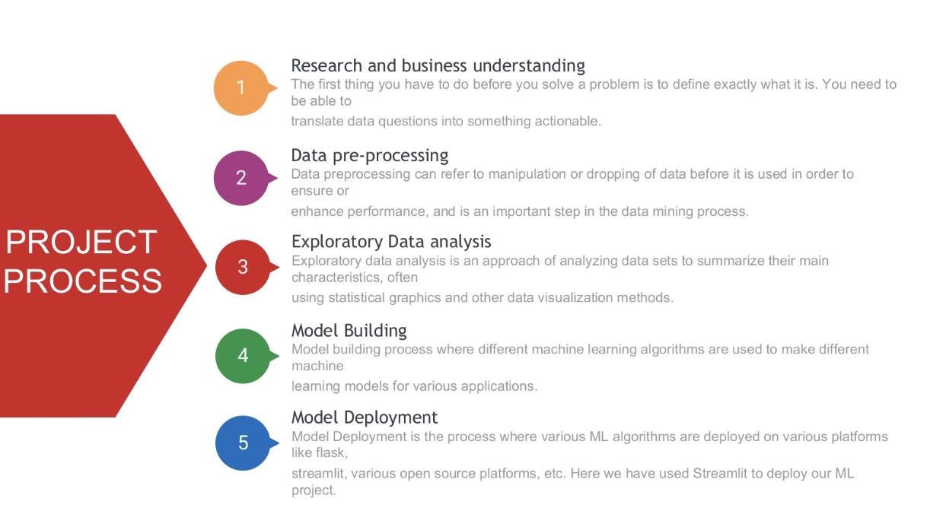

Slide 10
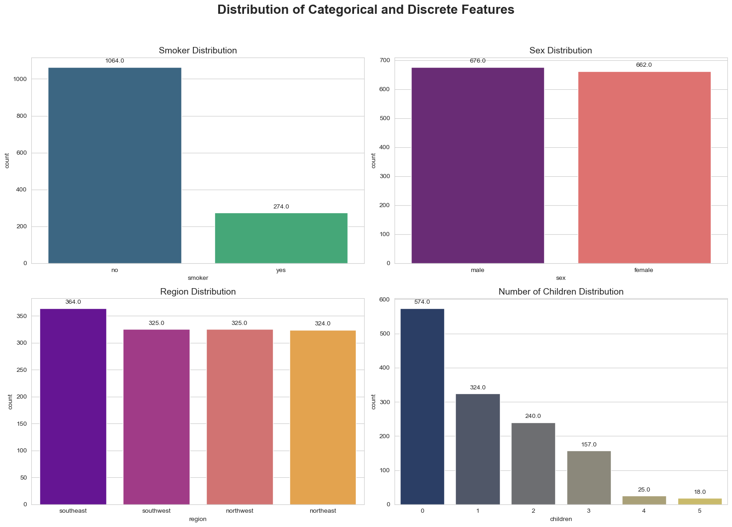
VISUALIZATION OF DATA (EDA)

Slide 11
The displayed chart is a multi-panel bar plot (count plot) created using Python's Seaborn and Matplotlib libraries, commonly used during Exploratory Data Analysis (EDA). It shows the distribution of four categorical and discrete features: smoker status, sex, region, and number of children. The Smoker Distribution plot reveals that the majority of individuals in the dataset are non-smokers (1064), with only 274 being smokers, indicating a class imbalance. The Sex Distribution shows a nearly equal count of males (676) and females (662), suggesting a balanced gender representation.
The Region Distribution indicates that individuals are fairly evenly spread across all four regions—southeast, southwest, northwest, and northeast—with the southeast region having a slightly higher count (364). The Number of Children Distribution plot highlights that most people have no children (574), and the number of individuals decreases as the number of children increases, with very few having four or five children.
This type of chart is used to visually summarize categorical and discrete data, helping analysts quickly understand data composition, detect class imbalances, and make informed preprocessing decisions before modeling.

Slide 12
MODEL BUILDING:
Multiple Linear Regression: Served as a baseline model.
Ridge Regression: Tested regularization impact on linear models.
Gradient Boosting Regressor: Captured complex, non-linear relationships.
Random Forest Regressor: Another ensemble model tested for performance and robustness.
Evaluation Metrics:
R-squared (R²): Measures how well the variance in the target is explained.
Mean Absolute Error (MAE): Measures average prediction error in dollar terms.
Root Mean Squared Error (RMSE): Penalizes larger errors more than MAE.
Models were trained on 80% of data and tested on 20%.

Slide 13
BEST MODEL
Gradient Boosting Regressor
The Gradient Boosting Regressor is a powerful machine learning algorithm used for regression tasks. It is an ensemble learning technique that builds a strong predictive model by combining the outputs of multiple weak learners, typically decision trees. The algorithm works by training trees sequentially, where each new tree tries to correct the errors made by the previous ones. It uses gradient descent to minimize the loss function (e.g., Mean Squared Error in regression).

Slide 14
Why It Is Used: (Gradient Boosting Regressor)
In a medical expenses regression project, the goal is to predict a person's future healthcare costs based on features like age, sex, BMI, number of children, smoker status, and region. These relationships are often non-linear and may involve complex interactions between features.
Gradient Boosting Regressor is used because:
High Accuracy: It delivers excellent predictive performance by combining multiple trees and reducing bias and variance.
Handles Complex Data Well: It captures non-linear relationships and feature interactions effectively, which are common in medical expense data.
Feature Importance: It helps in identifying which factors (like smoking or BMI) contribute most to medical costs.
Customizable: It allows tuning of parameters (e.g., learning rate, number of trees, depth) to prevent overfitting and improve accuracy.
Robust to Outliers: It performs better than simple linear models in the presence of outliers or skewed data.

Slide 15
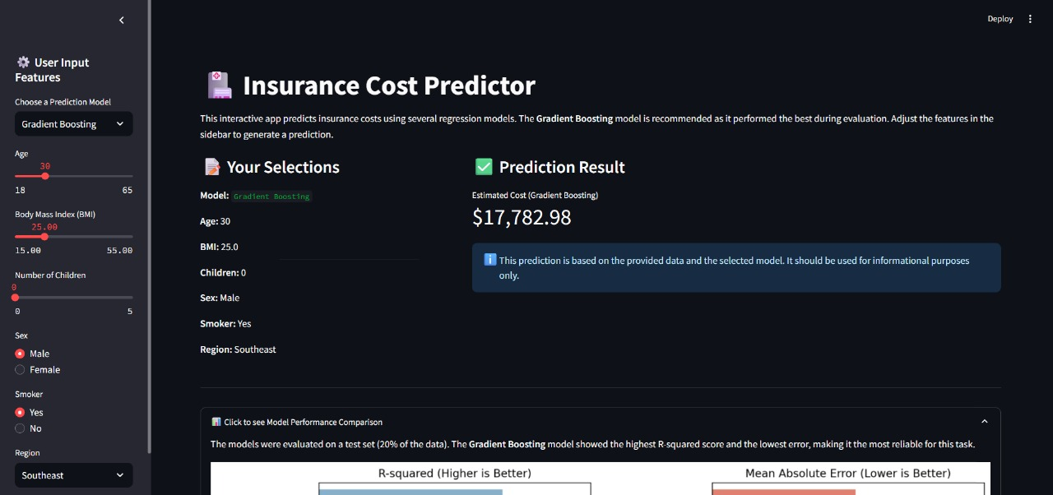
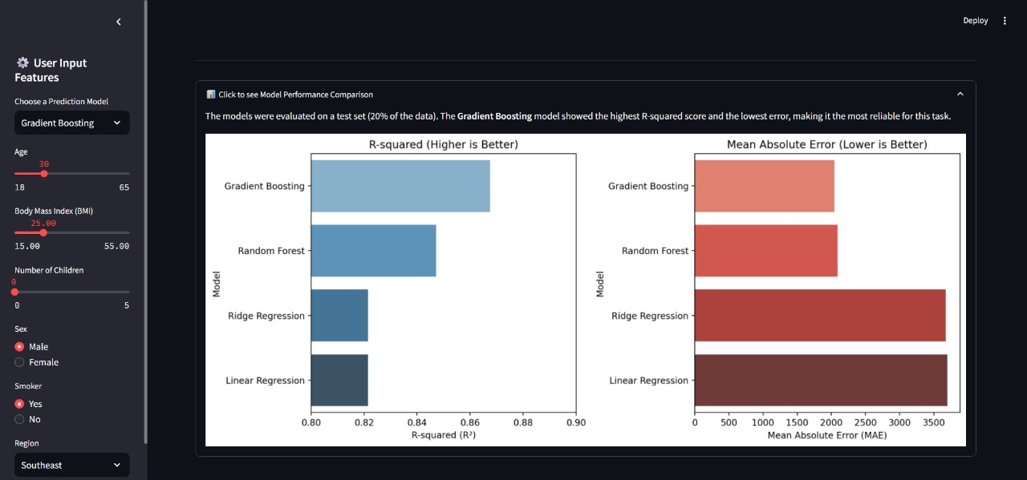
DEPLOYMENT

Slide 16


